Slide 1


ENCRIPTACIÓN DED FUNCIONES, VISTAS Y SP
Anthony Cardenas Aquino

Slide 2
ENCRIPTAR FUNCIONES
create function funcion_encriptada()
returns varchar
with encryption
as
begin
return 'hola mundo';
end

Slide 3
ENCRIPTAR VISTAS
create view v_encriptado
with encryption
as
select * from categorias;

Slide 4
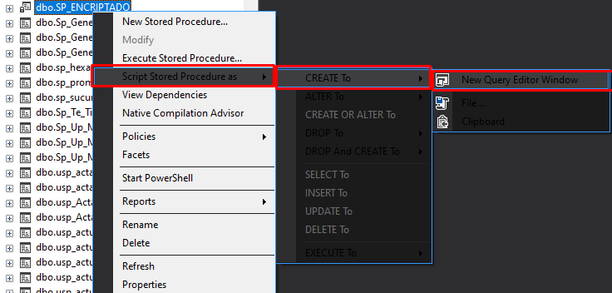
ENCRIPTACIÓN STORE PROCEDURE

Slide 5
ENCRIPTACIÓN STORE PROCEDURE
create procedure SP_ENCRIPTADO
WITH ENCRYPTION
AS
SELECT TOP 10 * FROM HABITANTE;

Slide 6

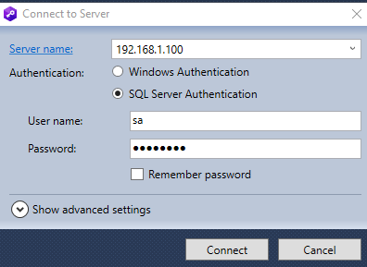
DESENCRIPTACIÓN STORE PROCEDURE
https://www.devart.com/dbforge/sql/sqldecryptor/download.html

Slide 7
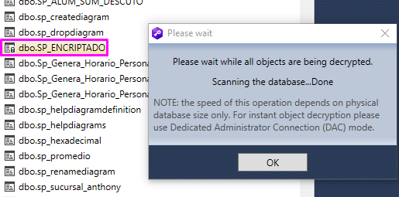
DESENCRIPTACIÓN STORE PROCEDURE

